Slide 1

Northwind Database
By Alain Leukam

Slide 2


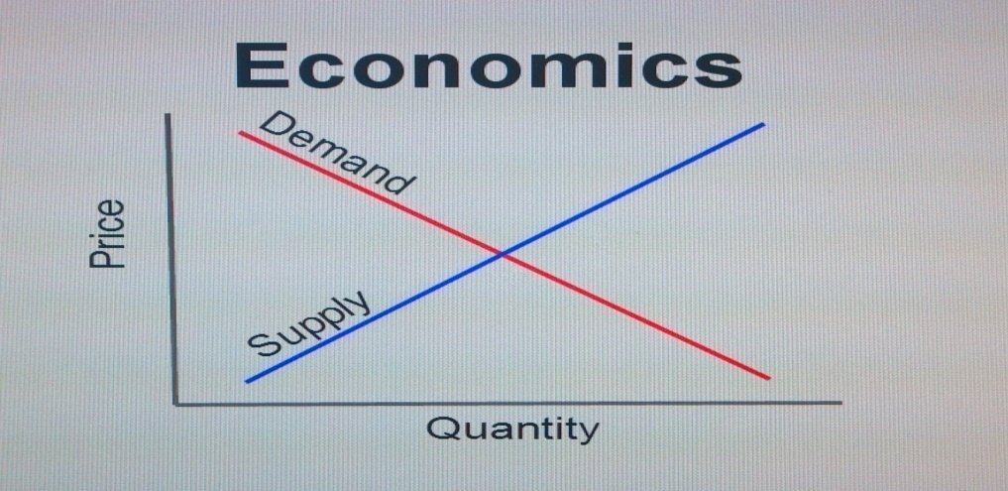
Analyzing a business model using statistic
Business value
Improve discount system
Performance review of the employees
Market demand

Slide 3

Methodology
Hypothesis Testing
Weltch Testing
ANOVA
Cohen’d

Slide 4


Are orders quantities affected by discounts? At which level of discount?
On average 70.0% of discounted products were sold in larger quantities Average order quantity with discount - 26.43 items, without - 21.81 items
More products were ordered at the discounts level of 15%, 20% and 25%

Slide 5

Which employees gave the more discounts? Employees in USA or UK
On average, the discounts given by employees from the USA is not different from the discounts given by employees from the UK.
More discounts were given in USA compare to UK.
The sale politic in USA may be to encourage the employee to offer discount more frequently to customers. This could be an object of further research.

Slide 6

Does the employees in USA and UK sold the same quantity of product on average?
There is a difference between the quantity of products sold in the USA versus the UK.
Our research actually showed that the employees in USA sold more product than their counterparts in UK. This is probably linked to their flexibility to offer discount to their customers.

Slide 7

Processing time
There is no significant difference between the processing time per order in the USA versus the UK. The average of the processing times in both country is showing a slight advantage to USA(lower processing time per employee). We can conclude that the employees in the USA are slightly more performant than the employees in UK.

Slide 8

Further research
1- Shipping companies performance evaluation.
2-Type of customers swayed by discounts.
3-Why employees in USA sold more products than those in UK?

